Slide 1

Flux de Contrôle

Slide 2
Avant de commencer:
Des questions sur Karel?

Slide 3
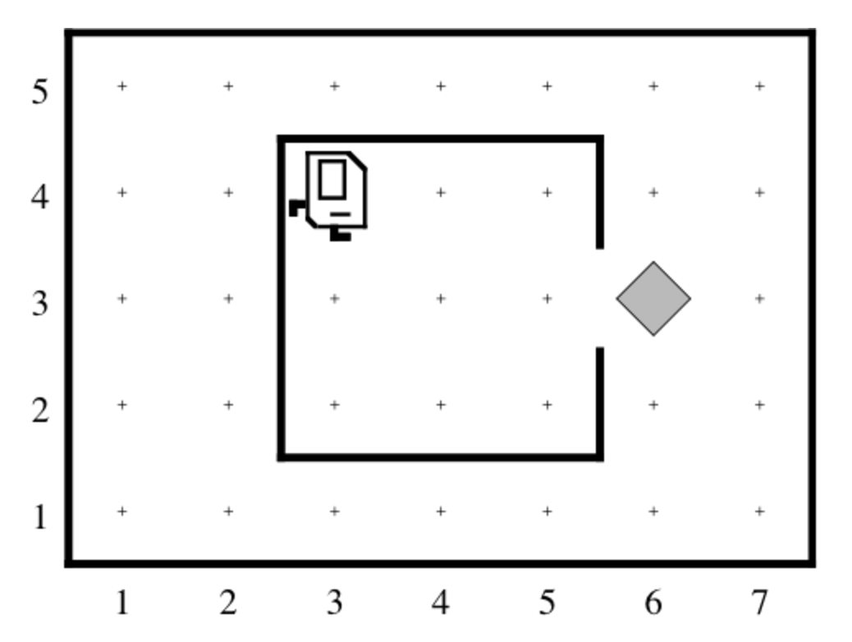
Puiser de l’eau Karel
Avez-vous eu du mal à accomplir cette tâche?

Slide 4
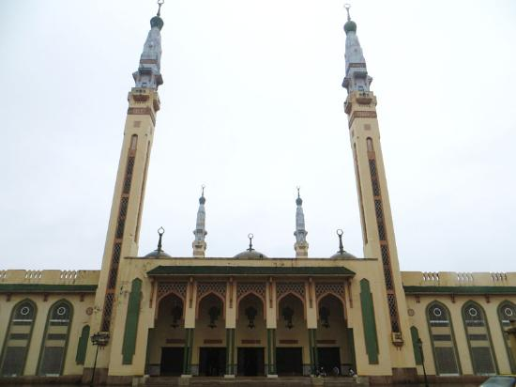
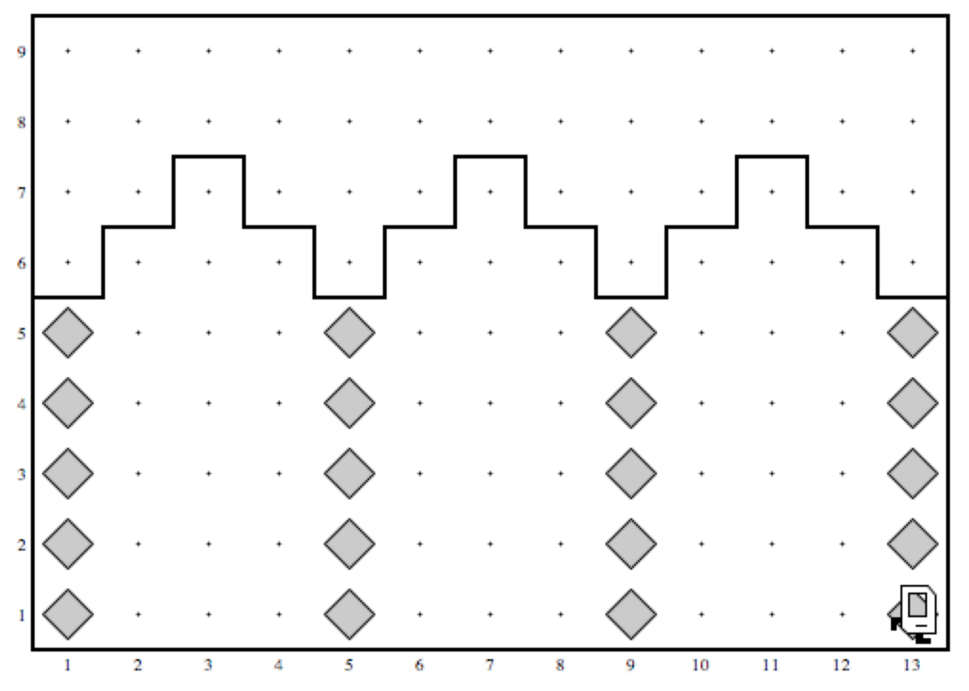
Vous savez comment faire construire à Karel la Grande Mosquée de Conakry

Slide 5
C’est amusant!...

Slide 6
…mais un robot doit se preparer
aux dangers du monde
Notes:
Get someone to come up with a blindfold and try to do

Slide 7
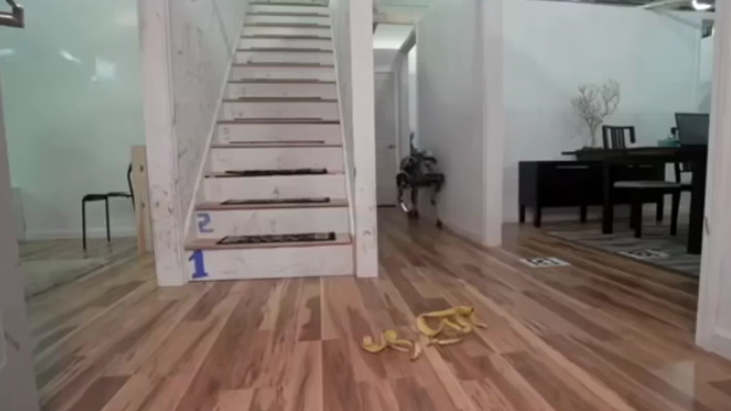

Slide 8
…sensibilization à l’environnement
peux sauver des vies

Slide 9
…awareness about the environment
would save lives
Karel should know how to:
…count the steps

Slide 10
…awareness about the environment
would save lives
Karel should know how to :
…count the steps
…check what’s around

Slide 11
…awareness about the environment
would save lives
Karel should know how to :
…count the steps
…check what’s around
…adjust to the environment

Slide 12
But first:
Who likes dancing here?

Slide 13
Yanar Döner Karel
import stanford.karel.*;
public class YanarDoner extends SuperKarel {
public void run() {
//Dance
move();move();turnLeft();
move();move();turnLeft();
move();move();turnLeft();
move();move();turnLeft();
}
}
Doing it once is not real dance, what about
some more ‘loops’

Slide 14
Yanar Döner Karel
import stanford.karel.*;
public class YanarDoner extends SuperKarel {
public void run() {
//Dance
for(int i=0;i<4;i++) {
move();move();turnLeft();
move();move();turnLeft();
move();move();turnLeft();
move();move();turnLeft();
}
}
}

Slide 15
Yanar Döner Karel
import stanford.karel.*;
public class YanarDoner extends SuperKarel {
public void run() {
//Dance
for(int i=0;i<4;i++) {
for(int k=0;k<4;k++) {
move();move();turnLeft();
}
}
}
}

Slide 16

Understanding for loops
for(int numTickets = 3; numTickets > 0; numTickets--) {
dance();
}
Initialization: int numTickets = 3;
Condition check: numTickets > 0;
The loop
Update/decrement: numTickets--

Slide 17
Understanding for loops
for(int numTickets = 3; numTickets > 0; numTickets--) {
dance();
}
for(int i = 0; i < 4; i++) {
dance();
}
You can stick to the example until we talk about int and ++

Slide 18
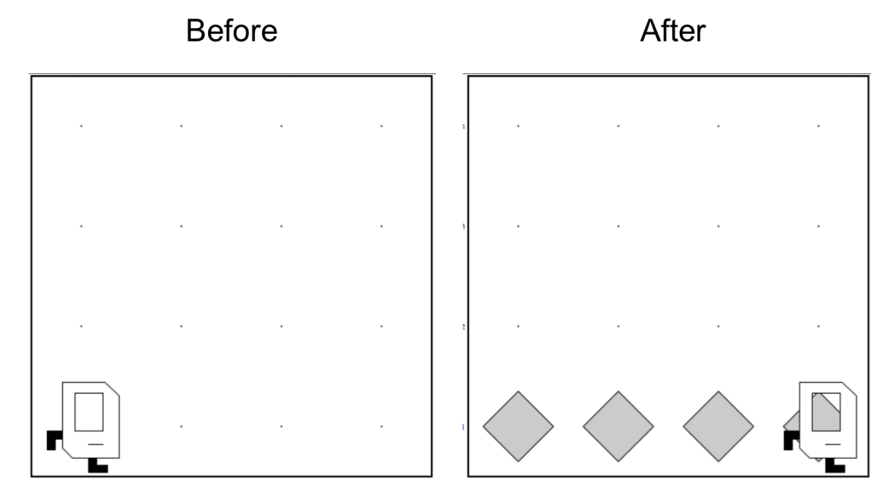
Don’t Know World Size
?

Slide 19
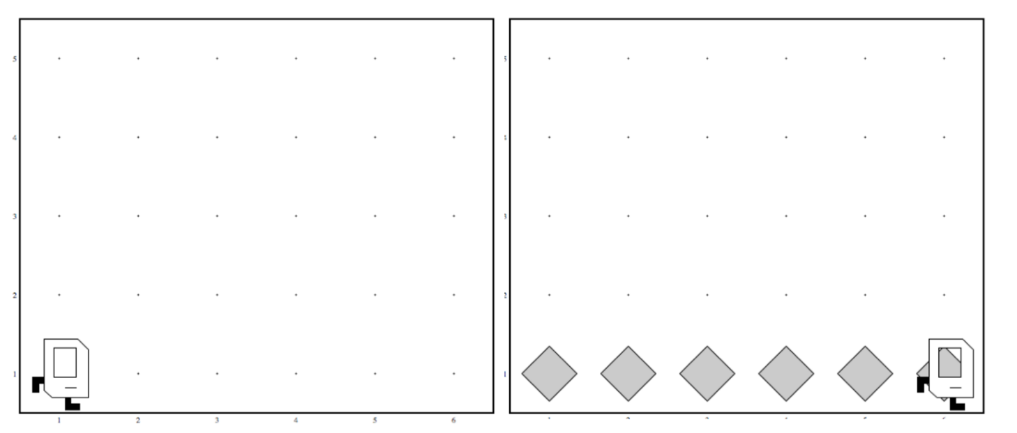
Work in Any World
Before
After
Before
After

Slide 20
While Loop

Slide 21
While Loop
import stanford.karel.*;
public class BeeperLine extends SuperKarel {
public void run() {
// example while loop
while(condition) {
code to repeat
}
}
}
Check the condition
True -> execute
Check the condition
True -> execute
….
Check the condition
False-> don’t execute.
Continue the rest of the program

Slide 22
Place Beeper Line
import stanford.karel.*;
public class BeeperLine extends SuperKarel {
public void run() {
// example while loop
while(frontIsClear()) {
move();
}
// extra put beeper
putBeeper();
}
}
Any guess what this code will do?
How should we modify it to have beepers on the line?

Slide 23
Place Beeper Line
import stanford.karel.*;
public class BeeperLine extends SuperKarel {
public void run() {
// example while loop
while(frontIsClear()) {
putBeeper();
move();
}
// extra put beeper
putBeeper();
}
}

Slide 24
Place Beeper Line
import stanford.karel.*;
public class BeeperLine extends SuperKarel {
public void run() {
// example while loop
while(frontIsClear()) {
putBeeper();
move();
}
// extra put beeper
putBeeper();
}
}

Slide 25
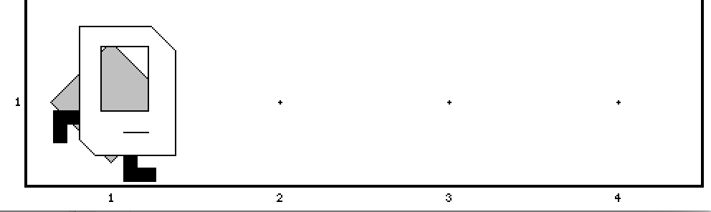
Place Beeper Line
import stanford.karel.*;
public class BeeperLine extends SuperKarel {
public void run() {
// example while loop
while(frontIsClear()) {
putBeeper();
move();
}
// extra put beeper
putBeeper();
}
}

Slide 26
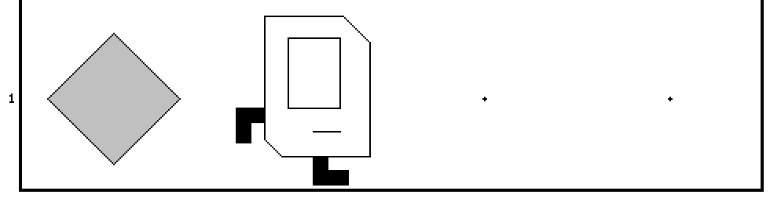
Place Beeper Line
import stanford.karel.*;
public class BeeperLine extends SuperKarel {
public void run() {
// example while loop
while(frontIsClear()) {
putBeeper();
move();
}
// extra put beeper
putBeeper();
}
}

Slide 27
Place Beeper Line
import stanford.karel.*;
public class BeeperLine extends SuperKarel {
public void run() {
// example while loop
while(frontIsClear()) {
putBeeper();
move();
}
// extra put beeper
putBeeper();
}
}

Slide 28
Place Beeper Line
import stanford.karel.*;
public class BeeperLine extends SuperKarel {
public void run() {
// example while loop
while(frontIsClear()) {
putBeeper();
move();
}
// extra put beeper
putBeeper();
}
}

Slide 29
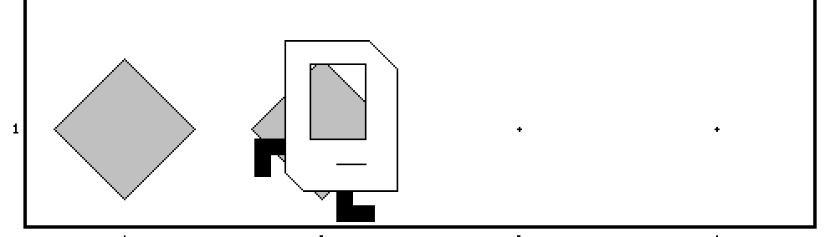
Place Beeper Line
import stanford.karel.*;
public class BeeperLine extends SuperKarel {
public void run() {
// example while loop
while(frontIsClear()) {
putBeeper();
move();
}
// extra put beeper
putBeeper();
}
}

Slide 30
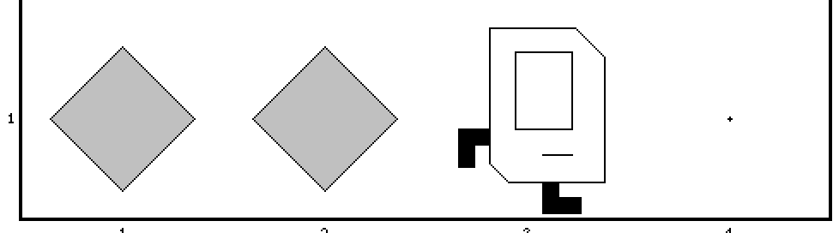
Place Beeper Line
import stanford.karel.*;
public class BeeperLine extends SuperKarel {
public void run() {
// example while loop
while(frontIsClear()) {
putBeeper();
move();
}
// extra put beeper
putBeeper();
}
}

Slide 31
Place Beeper Line
import stanford.karel.*;
public class BeeperLine extends SuperKarel {
public void run() {
// example while loop
while(frontIsClear()) {
putBeeper();
move();
}
// extra put beeper
putBeeper();
}
}

Slide 32
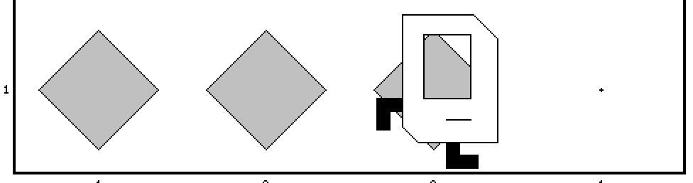
Place Beeper Line
import stanford.karel.*;
public class BeeperLine extends SuperKarel {
public void run() {
// example while loop
while(frontIsClear()) {
putBeeper();
move();
}
// extra put beeper
putBeeper();
}
}

Slide 33
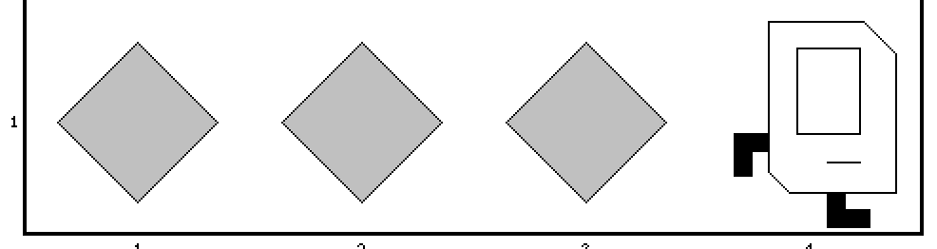
Place Beeper Line
import stanford.karel.*;
public class BeeperLine extends SuperKarel {
public void run() {
// example while loop
while(frontIsClear()) {
putBeeper();
move();
}
// extra put beeper
putBeeper();
}
}

Slide 34
Place Beeper Line
import stanford.karel.*;
public class BeeperLine extends SuperKarel {
public void run() {
// example while loop
while(frontIsClear()) {
putBeeper();
move();
}
// extra put beeper
putBeeper();
}
}

Slide 35
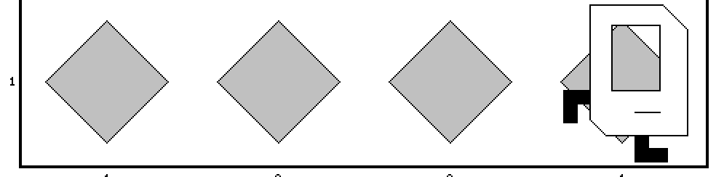
Place Beeper Line
import stanford.karel.*;
public class BeeperLine extends SuperKarel {
public void run() {
// example while loop
while(frontIsClear()) {
putBeeper();
move();
}
// extra put beeper
putBeeper();
}
}

Slide 36
Which Loop
Repeat Process
Know how many times
Don’t know how many times
For Loop
While Loop

Slide 37
What if you only want to perform a single loop based on a condition?

Slide 38
If statement

Slide 39
If Statement
import stanford.karel.*;
public class IfExample extends SuperKarel {
public void run() {
// example of an if statement
if(condition) {
code to run if condition is true
}
}
}

Slide 40
If Statement
import stanford.karel.*;
public class IfExample extends CSBridgeStudent{
public void run() {
// example of an if statement
if(youAreInCSBridge()) {
raiseYourHand();
}
}
}
Assume yourself as Karel and execute this program!

Slide 41
Let’s teach Karel to be more carefully and stop killing itself trying to go through the walls.
Could there be a safer way to move?

Slide 42
If Statement
import stanford.karel.*;
public class IfExample extends SuperKarel{
public void run() {
safeMove();
}
private void safeMove() {
if(frontIsClear()) {
move();
}
}
}

Slide 43
We can also specify what will happens if the condition is false

Slide 44
If else statement

Slide 45
Karel goes to the army:
If there is beeper take it
If there is no beeper put one
… silly? That’s the point!

Slide 46
If / Else Statement
import stanford.karel.*;
public class IfExample extends SuperKarel{
public void run() {
invertBeeper();
}
private void invertBeeper() {
if(beeperPresent()) {
pickBeeper();
} else {
putBeeper();
}
}
}

Slide 47
Karel Conditions

Slide 48
Your tasks this afternoon

Slide 49
1. Program Build Efes Karel

Slide 50
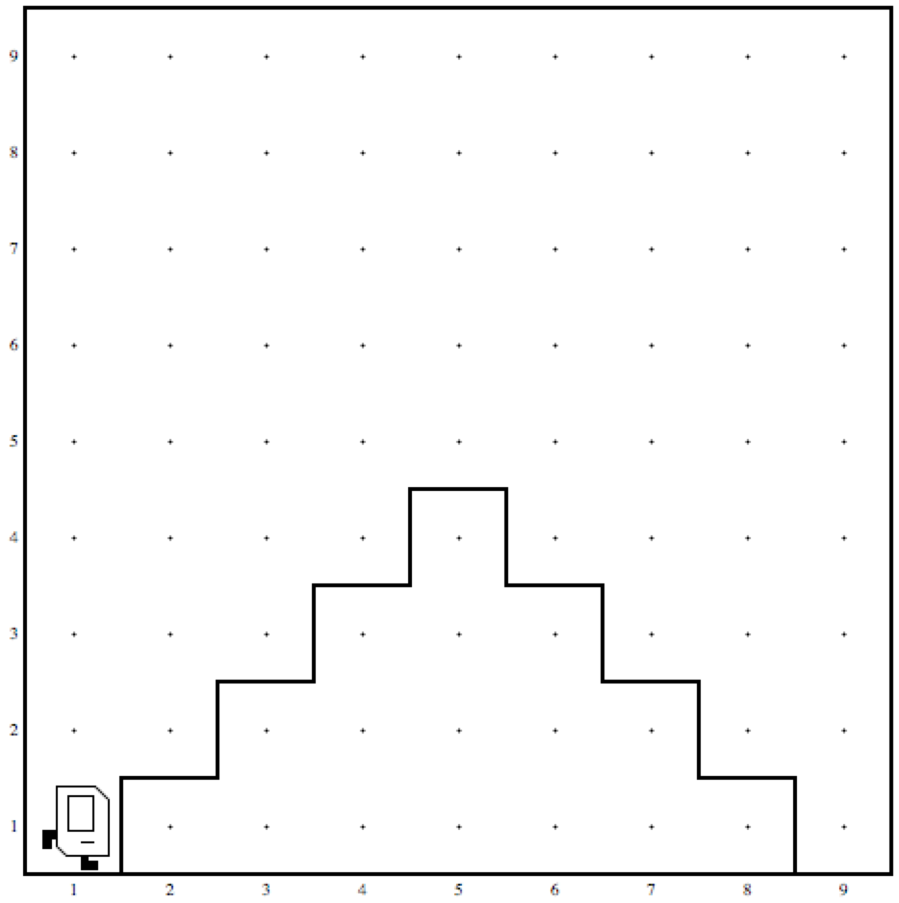
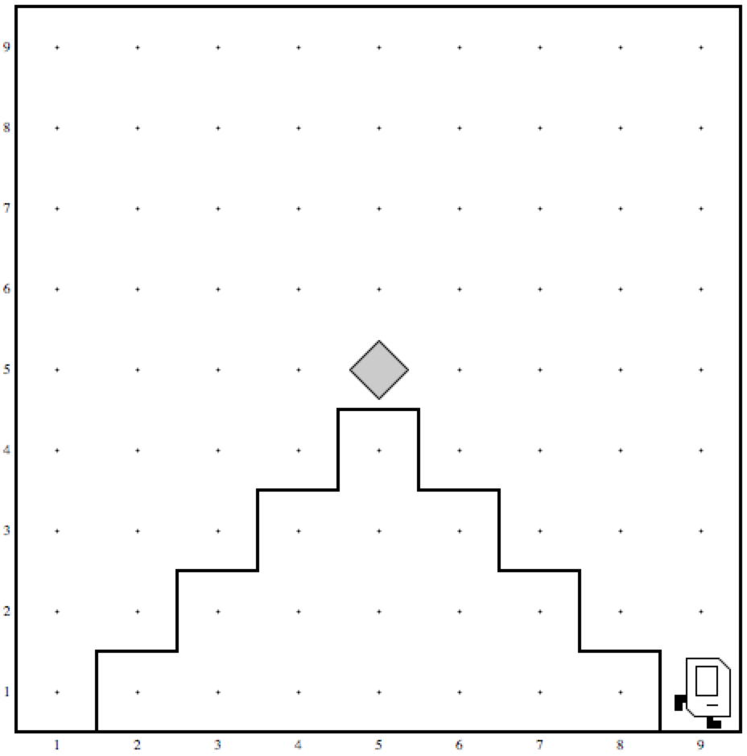
2. Mountain Karel
Before
After

Slide 51
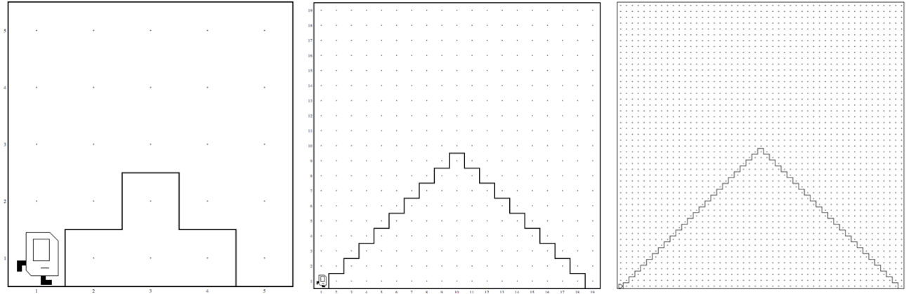
2. Mountain Karel
Should work on a world
of any size ☺

Slide 52
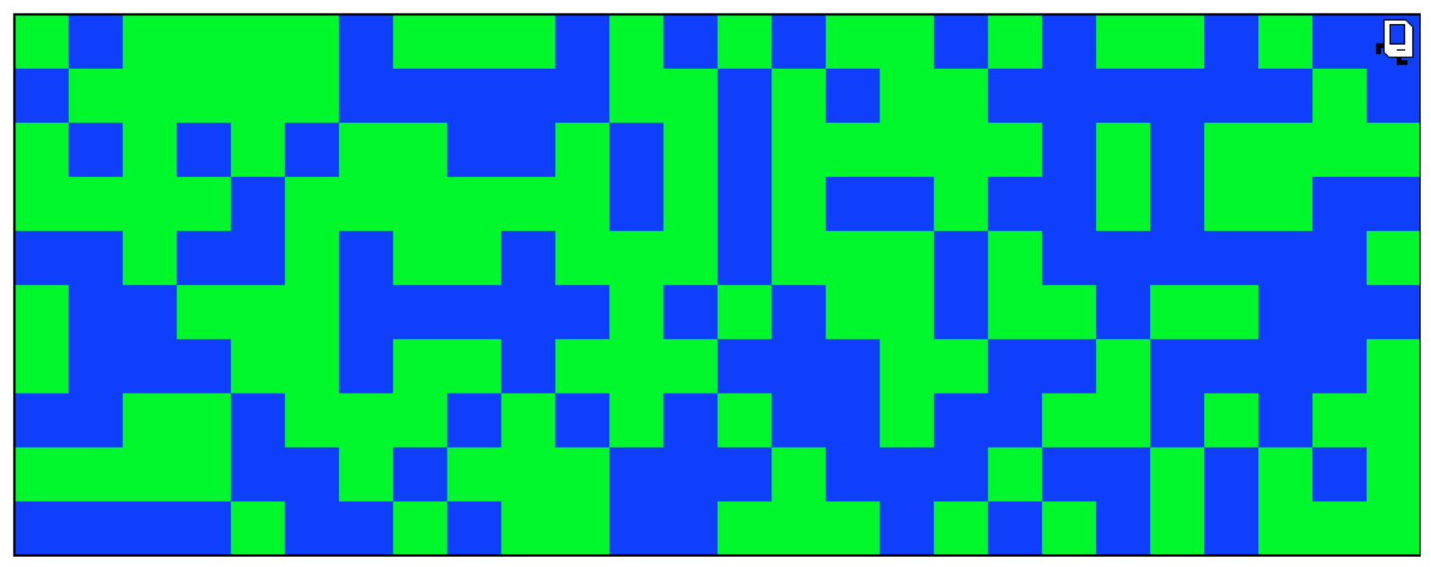
3. Random Painter

Slide 53
What if I finish early?

